Slide 1
Web Dev 2: ASP.NET Core 1.0 Internals
Code Labs

Slide 2
Welcome to Code Labs
Minimal slides
Lots of hands on coding
Don’t worry if you don’t finish
(code and docs are public)
Sessions are filmed
Get help from a proctor if you’re stuck!

Slide 3
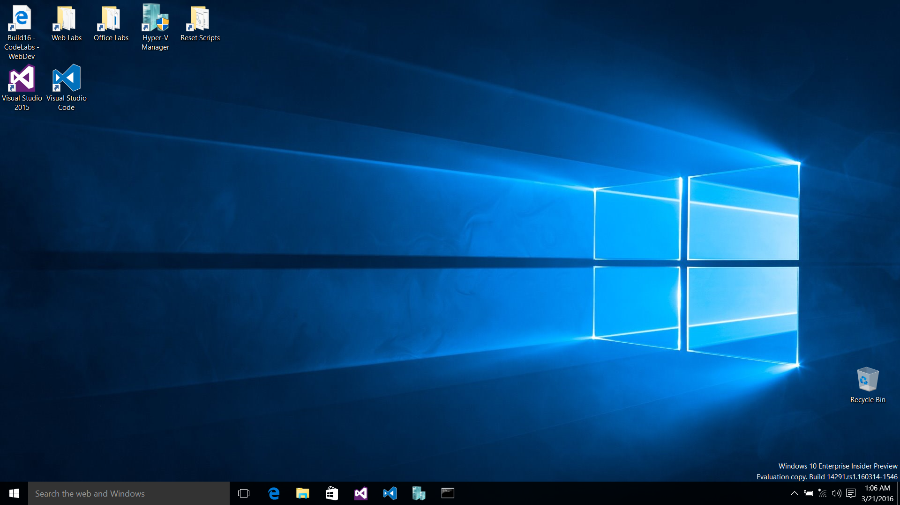

Slide 4
Code Labs: Web Dev track
Module 1 – Intro to ASP.NET Core
Module 2 – ASP.NET Core 1.0 Internals
Module 3 – Deployment and Azure w/ ASP.NET Core
Module 4 – Front End Web Development
Best if you do them in order, but not required

Slide 5
Module 2: ASP.NET Core 1.0 Internals
Working with Static Files
Intro to Routing and MVC
Writing Custom Middleware
Add Authentication to your Web Applications
Disclaimer: This is an advanced session

Slide 6
Exercise 1: Working with Static Files
Task 1 - Serving Static Files
Task 2 - Adding Default Document Support
Notes:
Time: TBD

Slide 7
Exercise 2: Intro to Routing and MVC
Notes:
Time: TBD

Slide 8
Exercise 3: Writing Custom Middleware
Task 1 - Writing Inline Middleware
Task 2 - Moving the Middleware to its own Type
Task 3 - Adding Options to Middleware
Task 4 - Reading Request Culture Config from a File
Task 5 - Flowing Options from DI to Middleware
Notes:
Time: TBD

Slide 9
Exercise 4: Add Authentication
Task 1 - Introduction to ASP.NET Identity
Task 2 - Enabling Auth using External Providers
Notes:
Time: TBD

Slide 10
Wrap-up
Notes:
Do this in the last 5 minutes of the event

Slide 11
Web Dev Code Lab Related Sessions Wednesday 03/30
11:30 – 12:30
14:00 – 15:00 | Microsoft Edge: What's Next for Microsoft's New Browser and Web Platform Moscone 2001
15:30 – 16:30 | What’s New in Typescript Marriott 9
17:00 – 18:00

Slide 12
Web Dev Code Lab Related Sessions Thursday 03/31
11:30 – 12:30
14:00 – 15:00
15:30 – 16:30 | Web Apps Across Windows Devices Moscone 2005
17:00 – 18:00 | ASP.NET Core 1.0 Marriott 9
18:30 – 19:30

Slide 13
Web Dev Code Lab Related Sessions Friday 04/01
09:00 – 10:00 | Entity Framework Core 1.0 Marriott 8
10:30 – 11:30 | Deploying ASP.NET Core Apps Moscone 2001
12:30 – 13:30 | ASP.NET Core: MVC Deep Dive Marriott 9 | Web Platform: An Inside Look at What’s New for Microsoft EdgeHTML, ChakraCore, F12 Tools, and Microsoft Edge Extensions Moscone 2001
14:00 – 15:00

Slide 14
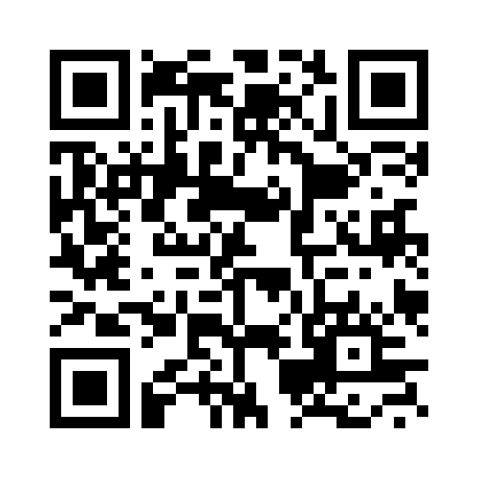
REVIEW THIS SESSION

